Slide 1
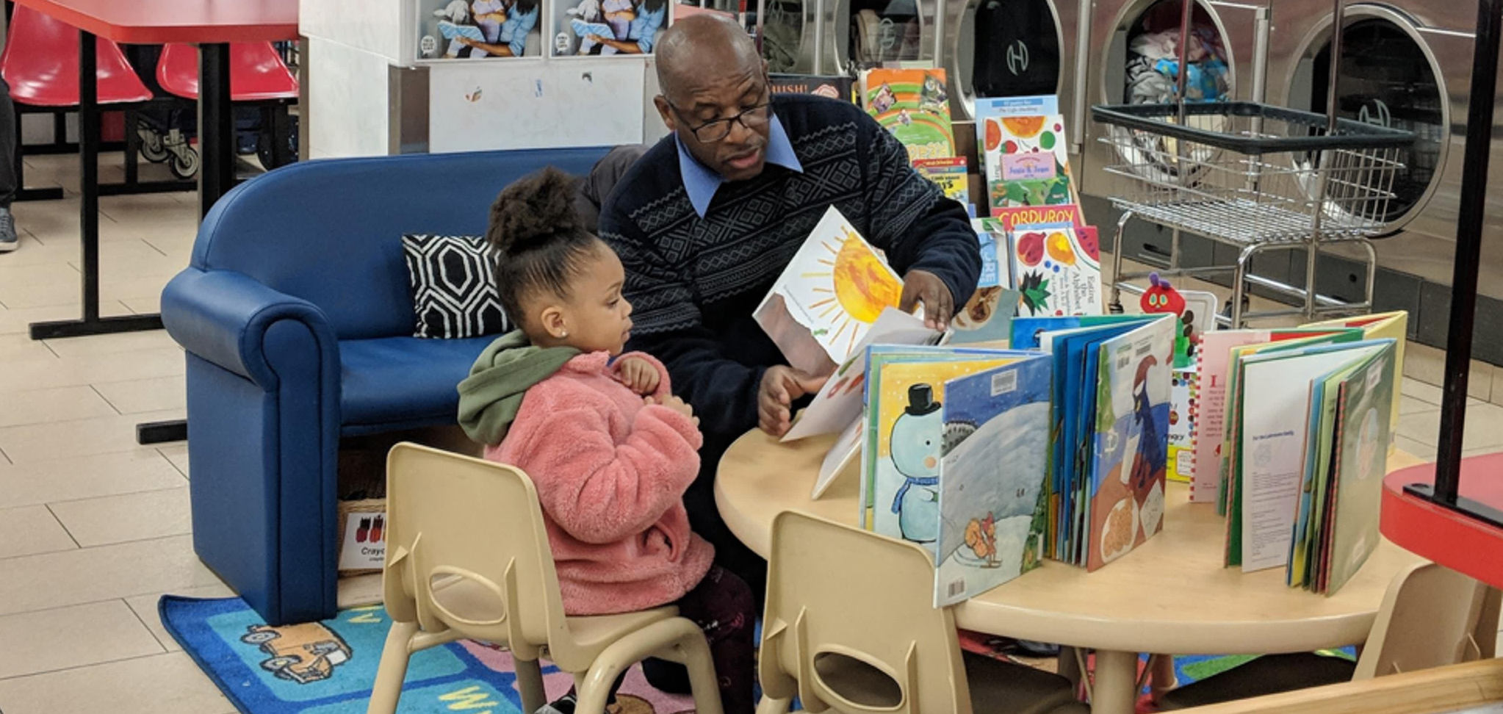



Welcome Laundromat Owners
What is one thing that has inspired you during our summit so far? Type your answer in the chat box!
Notes:
[Jeff reads aloud some of the responses as they are coming through.]

Slide 2
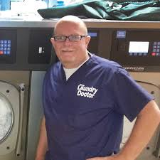
Jeff Gardner,
The Laundry Doctor
Welcome Laundromat Owners
Notes:
Jeff welcomes the laundromat owners who are attending this session, especially given this busy and challenging time during COVID-19.

Slide 3
Laundry Literacy Coalition
Awareness
Access
Action
Gain awareness on ways to get involved.
Increase access to FRPL spaces & books.
Create an action plan to serve kids & families.
Notes:
Jeff shares the key goals of this session:
Gain awareness about the different ways laundromat owners can get involved in promoting literacy at their laundromat.
Share ways owners can to increase families’ access to literacy rich spaces and resources. We’re aiming to get to 600 RPL sites by 2021. If owners have a space already, we’ll share how owners can use their stores as channels to distribute books for kids to take home and build home libraries.
Take action by mobilizing each owner to take small or big steps to create learning opportunities for children and families in under-resourced communities.

Slide 4
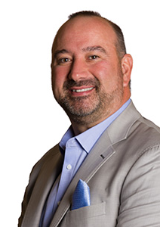
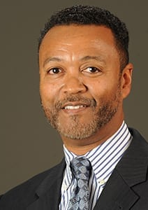
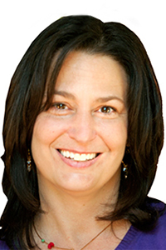

Brian Wallace
CEO,
Coin Laundry Association
Brian Holland
Owner,
Laundry Café
Jane Wolfe
Owner,
Wash World/Melba’s
Jim Whitmore
President,
WSI Laundry Corp
Notes:
Brian Holland, Jim Whitmore and Jane Wolfe each take 1 minute to help frame this time around the impact of installing an RPL space in their stores and making room for helping children succeed and supporting communities through this work. Acknowledge and thank the commitment of the 80+ laundromats that have already installed these spaces.

Slide 5
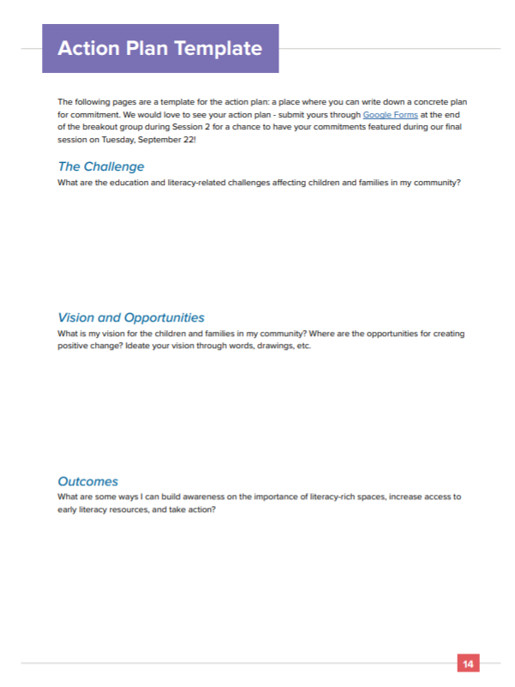


Action Plan
Two ways to submit:
Google Forms:
https://bit.ly/3ikcYFV
App:
https://bit.ly/3hBMTRl
Notes:
Now, it’s time for everyone to start drafting an Action Plan. This is by no means the final plan, but instead a starting point for industry leaders to start setting some goals and think about the information, resources, and partners needed to accomplish them. Jeff asks everyone to type in their answers onto the Google Form or on page 14 of Participant Guide in the app. Here are some ideas to get us started.

Slide 6
7 Ideas for Laundromat Owners
Transform your laundromat into a playful, literacy-rich space with a “Family Read, Play, & Learn” Kit.
Distribute books and family handouts with early literacy tips for parents (laundrycares.org/resources).
Join the LaundryCares network for free at laundrycares.org/join-the-laundrycares-network.
Let your attendants know of the importance of talking, reading and singing every day and encourage them to promote early learning with your guests.
Partner with your local library or community organization to conduct virtual story times and, when safe,
in-person story times.
Promote early math by incorporating Sidewalk Math patterns to the windows, floors, walls, and sidewalks of your laundromat.
Purchase discounted books through Scholastic’s Literacy Partnerships program for children to take home books and build a home library.
Notes:
Here are some ideas to get us started (show following text on a slide):
7 Ideas for Laundromat Owners
Transform your laundromat into a playful, literacy-rich space with a “Family Read, Play, & Learn” Kit.
Distribute books and family handouts with early literacy tips for parents (downloadable at www.laundrycares.org/resources).
Join the LaundryCares network for free at https://laundrycares.org/join-the-laundrycares-network/.
Let your attendants know of the importance of talking, reading and singing every day and encourage them to promote early learning with your guests.
Partner with your local library or community organization to conduct virtual storytimes and, when safe, in-person story times.
Promote early math by incorporating Sidewalk Math patterns to the windows, floors, walls, and sidewalks of your laundromat.
Purchase discounted books through Scholastic’s Literacy Partnerships (www.scholastic.com/literacypartnerships) program for children to take home books and build a home library. Scholastic’s Literacy Partnerships program provides each customer with a partnerships representative who would help them receive deep discounts on books.

Slide 7
Family Read Play & Learn Space
Notes:
Here are some visuals of these ideas and resources that we make available to our coalition partners.

Slide 8
Family Read Play & Learn Space
Notes:
Here are some visuals of these ideas and resources that we make available to our coalition partners.

Slide 9
Family Read Play & Learn Space
Family Posters & Handouts
Downloadable via LaundryCares Literacy Summit App under “Resources”
Notes:
Here are some visuals of these ideas and resources that we make available to our coalition partners.

Slide 10


Book Distribution
www.scholastic.com/literacypartnerships
Notes:
Here are some visuals of these ideas and resources that we make available to our coalition partners.

Slide 11
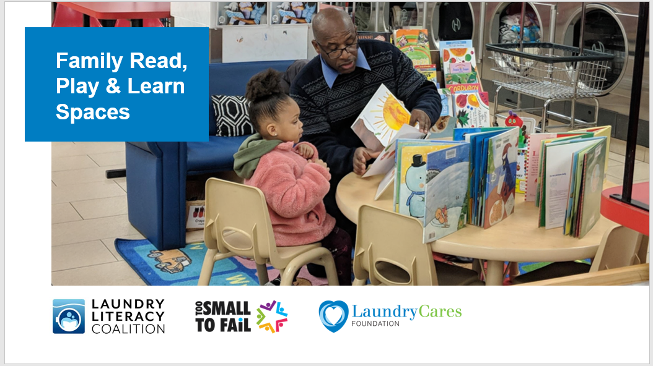
Resources for Industry Leaders
Marketing Deck
Kits Brochure
Downloadable via LaundryCares Literacy Summit App under “Resources”
Notes:
Here are some visuals of these ideas and resources that we make available to our coalition partners.

Slide 12
Action Plan
Two ways to submit:
Google Forms:
https://bit.ly/3ikcYFV
App:
https://bit.ly/3bw1dts
Notes:
Now it’s time for participants to create their own action plan with the guiding questions below. Please type in questions using the Google Form on the Participant Guide tab on the event portal or app. As participants reflect and work on their answers, Jane/Brian/Jim can help field questions in the chat box and/or provide commentary on each portion of the action plan questions.

Slide 13
The Challenge
What are the education and literacy-related challenges affecting young children and families in my community?

Slide 14
Vision & Opportunities
What is my vision for the children and families in my community?
Where are the opportunities for creating positive change? Ideate your vision through words, drawings, etc.

Slide 15
Outcomes
What are some ways I can build awareness on the importance of literacy-rich spaces, increase access to early literacy resources, and take action?
By when would I like to accomplish my goals?
What are some additional goals for the project that I would like to achieve?

Slide 16
Resources
What resources (space, time, funding, materials, etc.) do I already have to help create literacy-rich spaces and distribute early learning materials to families in my local laundromat(s)?
What resources do I need and what are steps I can take to acquire them?

Slide 17
Partners
Who are existing or new partners, and what could their potential roles be?
Who would I need to partner with to create literacy-rich laundromats in my community? How can I establish a connection with them?
Notes:
Partners (5 min): Who are existing or new partners, and what could their potential roles be? Who would I need to partner with to create literacy-rich laundromats in my community? How can I establish a connection with them?

Slide 18
Action Plan: Group Sharing
Use the “Raise Hand” button and share your commitment
with the group!
Notes:
Jeff invites participants to share by clicking on the “Raise Hand” button. Jeff selects 3 participants who can each take 5 minutes to share their action plans with the group.

Slide 19
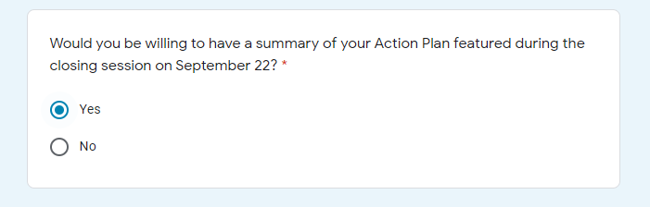
Next Steps
Submit your Action Plan!
Google Forms: https://bit.ly/3ikcYFV
Email: summit2020@laundrycares.org
We would love to feature your commitment during the closing session on September 22! Check “Yes” in the Google Form for a chance to be featured.
Notes:
Jeff thanks participants for the valuable discussion and asks everyone to please submit their Action Plans via Google Forms. Mention that we’d like to feature some of these commitments during the closing session on September 22nd, so if anyone is interested is having their action plan featured, please note this by clicking the checkbox in the Google Forms.

Slide 20

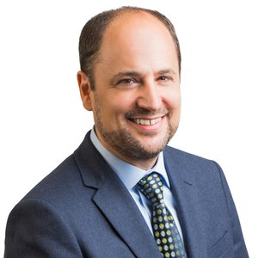
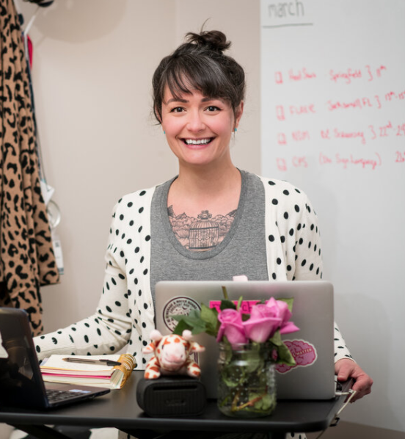
Film Screening & Exclusive Conversation
3:00–4:00p.m. ET Today
Greg Jacobs
Writer & Co-Director,
No Small Matter
Rachel Giannini
Preschool Teacher Featured in Film
Notes:
Jeff announces that at 3pm, we will be featuring a screening of the film No Small Matters followed by an exclusive conversation with Greg Jacobs, the film’s director and writer, along with Rachel Giannini, the preschool teacher featured in the film.

Slide 21

We look forward to seeing you again for our closing session on Tuesday, September 22 at 1:00 p.m. ET!
Join the LaundryCares Network for free!
laundrycares.org/join-the-laundrycares-network/
Notes:
We look forward to seeing everyone for Session 3 on September 22nd at 1pm with an opening keynote by Chelsea Clinton, a special conversation with New York Times Bestselling Author Mo Willems, and closing remarks by Ralph Smith, head of the Campaign for Grade Level Reading.

